Slide 1
KUBERNETES

Slide 2
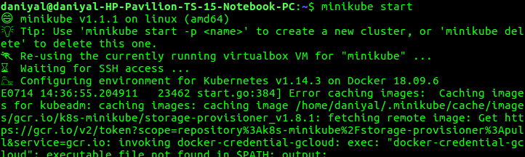
MINIKUBE
Minikube is a tool that makes it easy to run Kubernetes locally.
Minikube runs a single-node Kubernetes cluster on your laptop.
Kubernetes architecture consist of Master node and worker nodes
Minikube is a tool that makes it easy to run Kubernetes locally
Minikube runs a single-node Kubernetes cluster on your laptop to use kubernetes for practice or development
To start Kubernetes cluster using minikube.

Slide 3
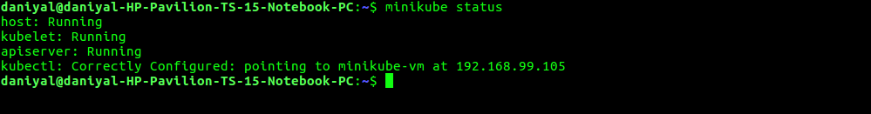
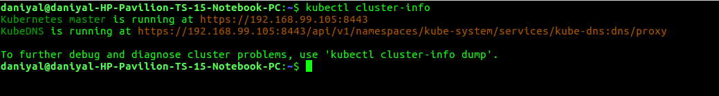
MINIKUBE COMMANDS
To check the minikube status
To check the cluster info like addresses of the kubernetes master and services

Slide 4
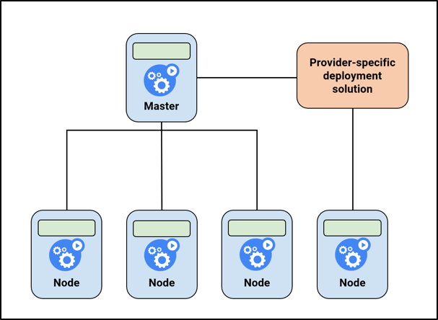
NODES
A node is a worker machine in Kubernetes.
A node may be a VM or physical machine.

Slide 5
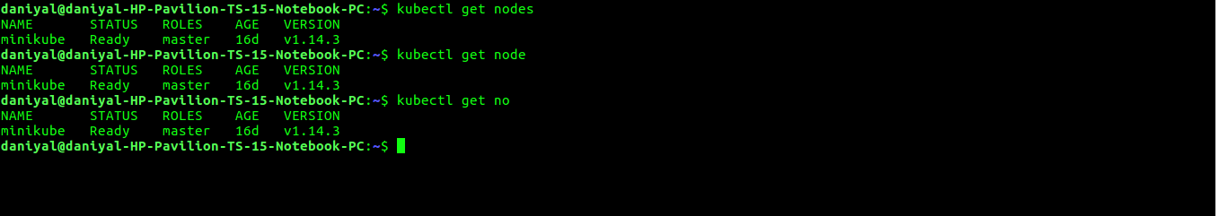
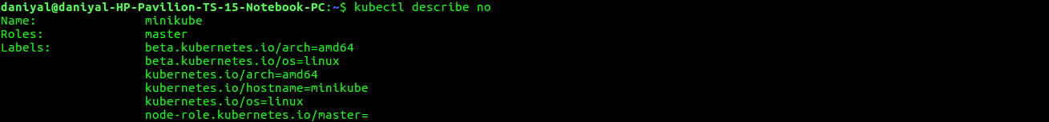
NODES
Get the list of the nodes
Get the detail of all nodes

Slide 6
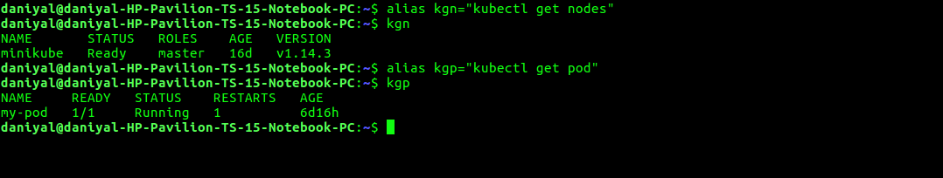
ALIAS
We can use alias command to make the long command shorter.

Slide 7
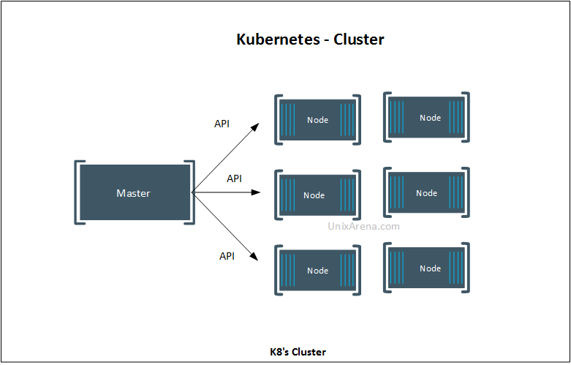
CLUSTER
Cluster is a set of nodes group together.
A CLUSTER consists of at least one master and multiple worker machines called nodes.

Slide 8
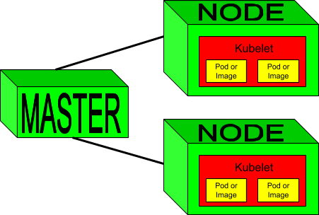
MASTER
The Kubernetes master is responsible for maintaining the desired state for your cluster.
The master components manage the state of the cluster. This includes accepting client requests (describing the desired state), scheduling containers and running control loops to drive the actual cluster state towards the desired state.

Slide 9
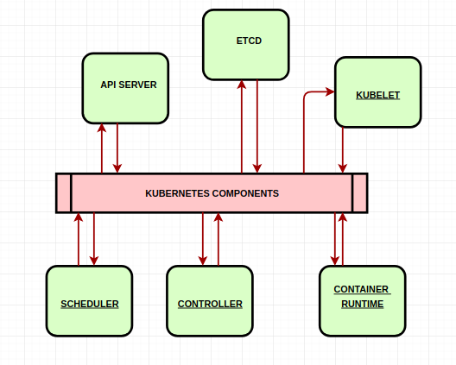
COMPONENTS
When install kubernetes on a system the following components install with it.

Slide 10
COMPONENTS
API Server
The API server acts as the frontend for kubernetes the users, management devices, command line interfaces all talk to the API Server to interact with the kubernetes cluster.
ETCD
Kubernetes uses etcd to store all its data. Its configuration data, its state, and its metadata.
Kubernetes is a distributed system, so it needs a distributed data store like etcd.
Etcd lets any of the nodes in the Kubernetes cluster read and write data.
SCHEDULER
The scheduler is responsible for distributing work or containers across multiple nodes. It looks for newly created containers and assigns them to nodes.
CONTROLLER
The controllers are the brain behind orchestration. They are responsible for noticing and responding when nodes, containers and end-points goes down.
The controllers make decisions to bring up new containers in such cases.

Slide 11
COMPONENTS
CONTAINER-RUNTIME
The container runtime is the underline software that is use to run containers, in our case it happens to be docker but there are other options as well.
KUBELET
The kubelet is the agent that runs on each node in the cluster.
The agent is responsible for making sure that the containers are running on the nodes as expected.

Slide 12
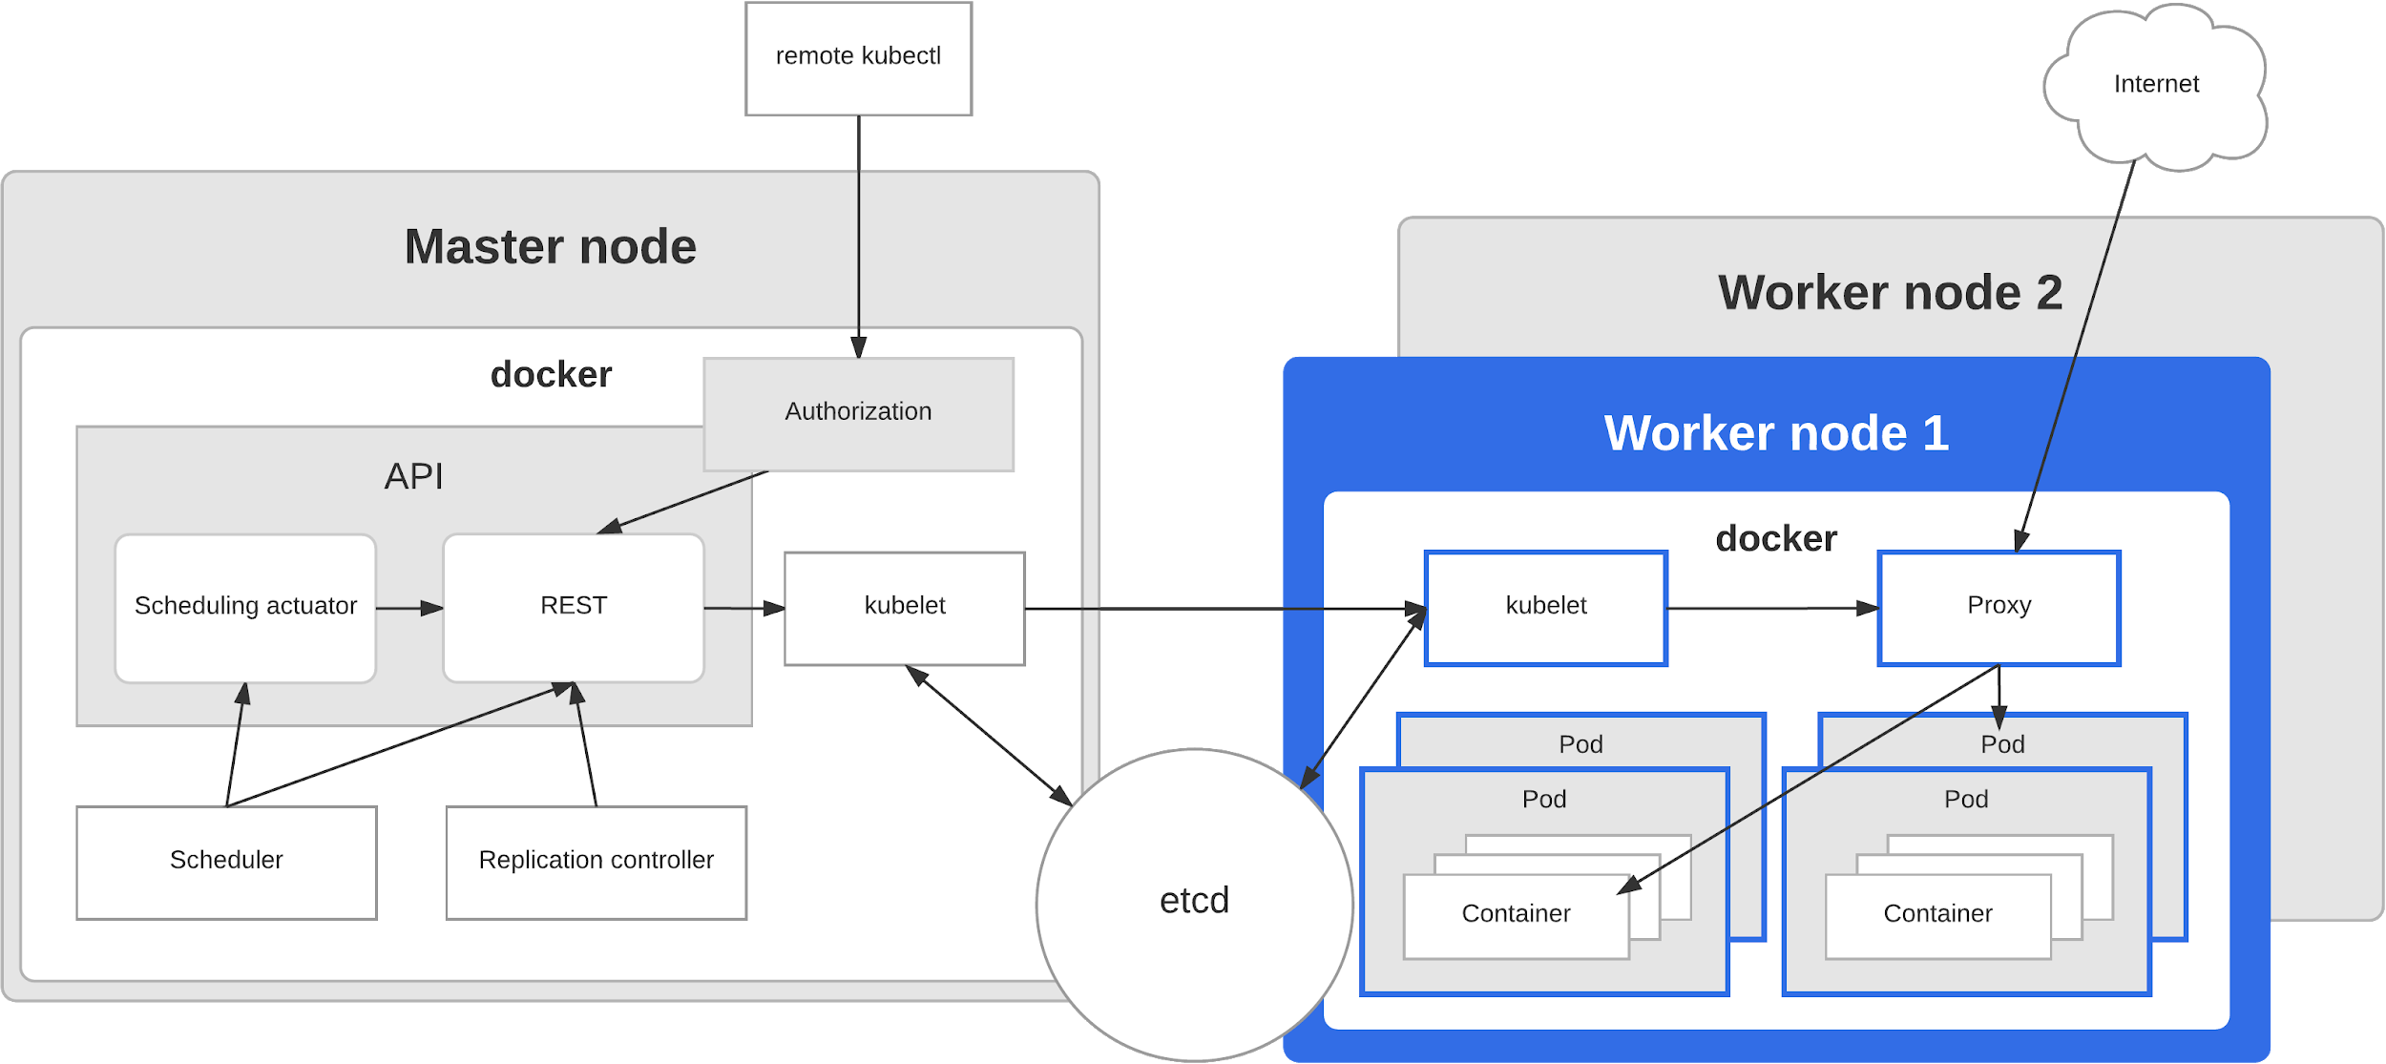
Master vs Worker Nodes

Slide 13
PODs
Kubernetes aim is to deploy our application in the form of containers on a set of machines that are configured as a worker nodes in a cluster.
Kubernetes does not deploy containers directly on the worker nodes.
The containers are encapsulated into a Kubernetes object known as POD’s.
A POD is a single instance of an application.
A POD is the smallest object that can create in kubernetes.

Slide 14
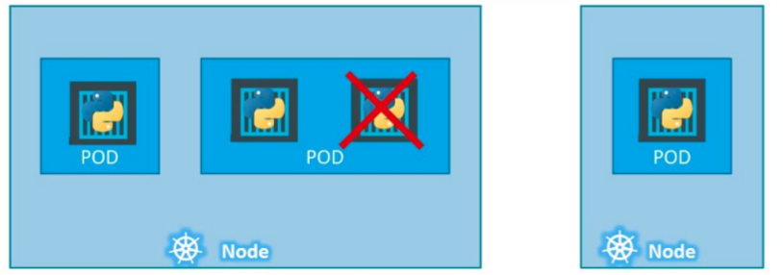
POD
A Kubernetes pod is a group of containers that are deployed together on the same host.
If you frequently deploy single containers, you can generally replace the word "pod" with "container" and accurately understand the concept.
To scale up your application, you add more pods. You delete pods if you scale down.

Slide 15
KUBECTL
The primary command line utility for interacting with a k8s cluster is kubectl.
Kubectl (Kube control tool) is use to deploy and manage applications on kubernetes cluster.
kubectl controls the Kubernetes cluster manager.
Kubectl is a command line interface for running commands against Kubernetes clusters.

Slide 16
Deploy A POD Using KUBECTL
What does kubectl run command?
It Deploys a Docker container by creating a POD.
It first creates a POD automatically and deploys an instance of the nginx Docker image.
Where does it get the application image from?
You need to specify the image name using the --image parameter.
The application image in this case the nginx image is downloaded from the docker hub repository.

Slide 17
POD
A pod of containers allows you to run closely related processes together
Kubernetes provide these containers with (almost) the same environment as if they were all running in a single container, while keeping them somewhat isolated
“Somewhat isolated”, this is because you want containers inside each group to share certain resources, although not all, so that they’re not fully isolated
For example if your main application’s container write logs in some file and you want another application to use some part of that log file and make some report.

Slide 18
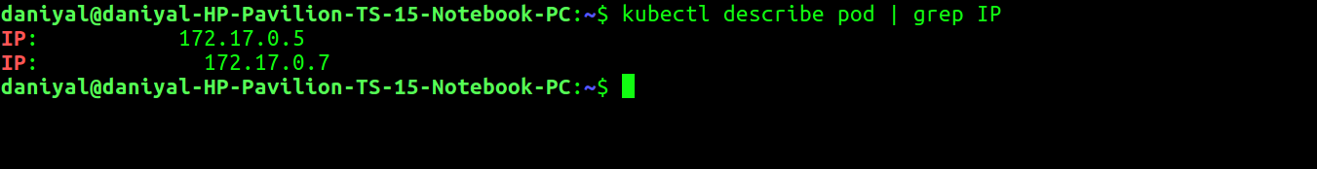
POD IPs
To get the POD IPs.

Slide 19
YAML FILE
It contains 4 mandatory top level specification:
a. apiVersion
b. Kind
c. metadata
d. spec

Slide 20
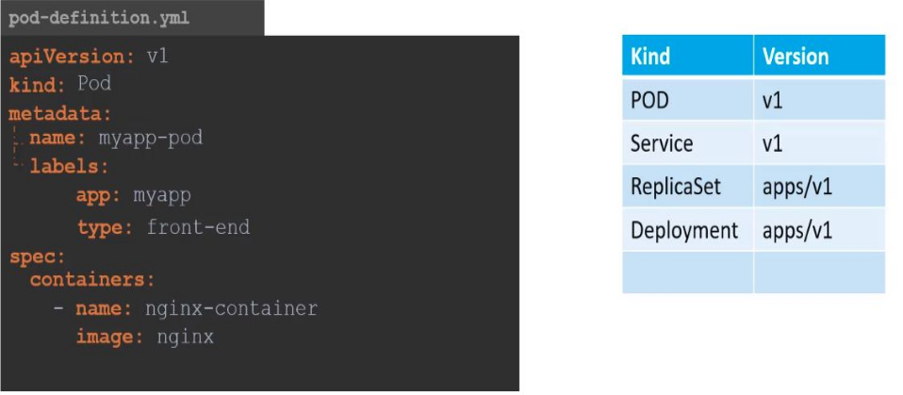
YAML

Slide 21
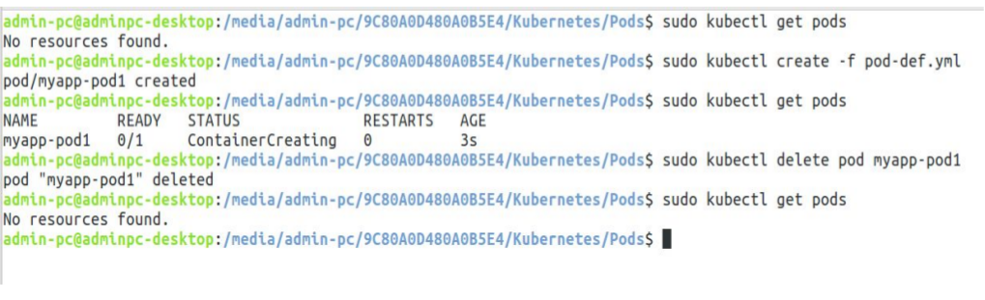
YAML

Slide 22
KUBERNETES Commands
1. Get Pods
a. Kubectl get pods
2. Delete Pods
a. Kubectl delete pod <pod name>

Slide 23
KUBERNETES
If you are given a pod definition file, edit that file and use it to create a new pod.
If you are not given a pod definition file​ , you may extract the definition to a file using.
the below command: ​ kubectl get pod <pod-name> -o yaml > pod-definition.yaml
Then edit the file to make the necessary changes, delete and re-create the pod.
Use the​ ​ kubectl edit pod <pod-name>​ ​ command to edit pod properties.

Slide 24
REPLICA
Kubectl replace -f filename
Kubectl scale --replicas=6 -f filename
Kubectl scale --replicas=6 replicaset <name>
Kubectl get po --show-labels

Slide 25
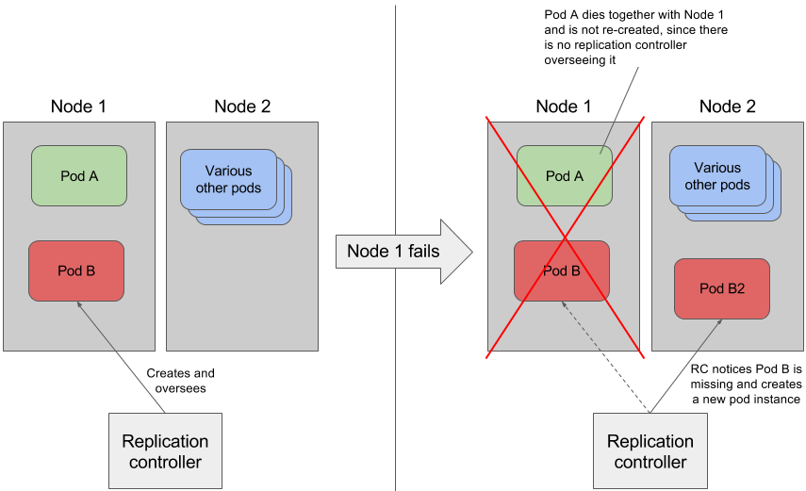
REPLICATION CONTROLLER
Replication controller is responsible to up new pod if previous one fails/crash to give high availability.
It also help us to create replica set of existing pods for scaling up.
Replication controller is older technology which is replaced by Replica Set

Slide 26
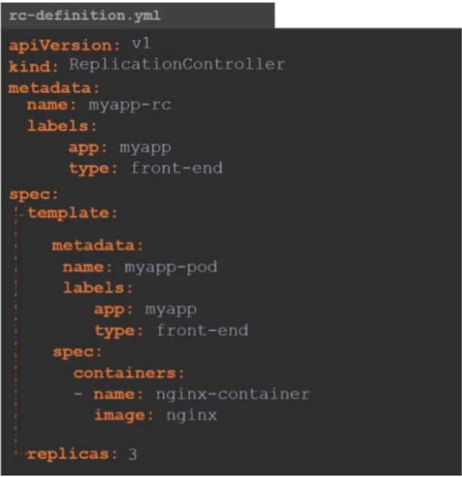
REPLICATION CONTROLLER

Slide 27
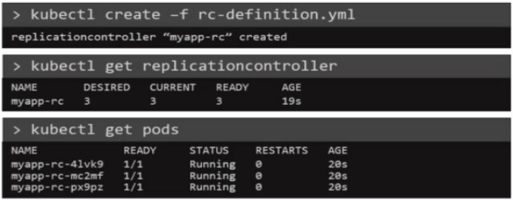
REPLICATION CONTROLLER

Slide 28
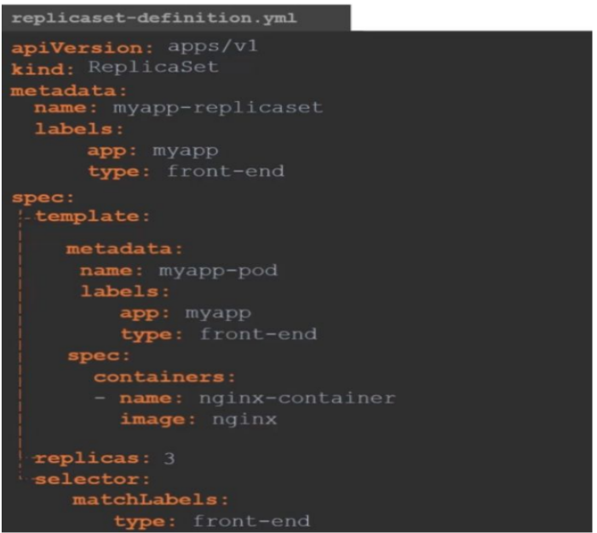
REPLICA-SET

Slide 29
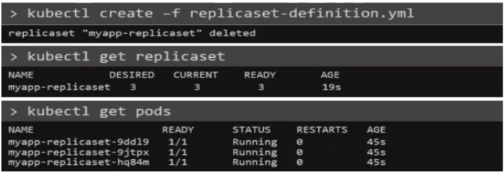
REPLICA-SET

Slide 30
REPLICATION VS REPLICA SET:
Replica set need apiVersion as ​ apps/v1 ​ while replication controller needs simple ​ v1 ​ as apiVersion
Replica set needs additional ​ selector​ property to select pods by their labels.
The major difference is that the rolling-update command works with ReplicationControllers, but won't work with a Replica Set. This is because Replica Sets are meant to be used as the backend for Deployments. Again, the pods that were created are deleted when we delete the Replica Set.

Slide 31
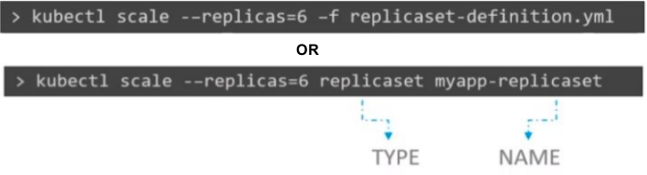
SCALING UP PODS
SCALING UP PODS:
1. You can either update number of pods in replicas of a replica set and run command:
Kubectl replace -f replica-def.yml.
2. You can also update replicas from command line but that will not update the definition file.

Slide 32
DELETING REPLICA SET
This command will delete all underlying pods too.

Slide 33
THANKS

